Slide 1
Review

Slide 2

Java

Slide 3
Three Properties of Variables
name
type
total
42
(contains an int)
value
Notes:
Type name = value

Slide 4
Types
// integer values
int num = 5;
// real values
double fraction = 0.2;
// letters
char letter = ‘c’;
// true or false
boolean isLove = true;
* Why is it called a double?

Slide 5
Binary Operators
+
Addition
*
Multiplication
–
Subtraction
/
Division
%
Remainder
Today is your day, tio

Slide 6
Remainder
// an example of the % operator
println(17 % 4);
// reads a number from the user
int num = readInt("?: ");
// stores the ones digit
int onesDigit = num % 10;
// equal to 1 if num is odd,
// 0 if num is even.
int isOdd = num % 2;

Slide 7
Binary Operators
+
Addition
*
Multiplication
–
Subtraction
/
Division
%
Remainder

Slide 8
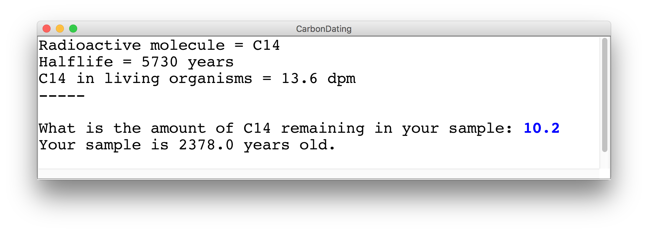
Challenge Carbon Dating
Write a program that can turn a measurement of C14 into an estimate of age.

Slide 9
Example: Carbon Dating
C14 = 1.2 dpm
C14 = 13.6 dpm

Slide 10
Carbon Dating Equation
Amount of C14 in your sample
Amount of C14 in a living sample
Half life of C14
Age of the sample
½ because of half life convention
* Some of these values are constants
** Use the function: Math.log( num )

Slide 11
End Review

Slide 12


Today’s Goal
Know how to use graphics variables
Understand For / While / If in Java

Slide 13

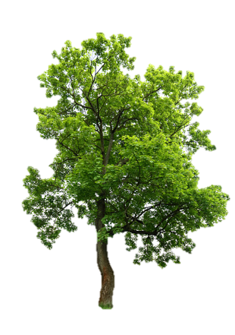
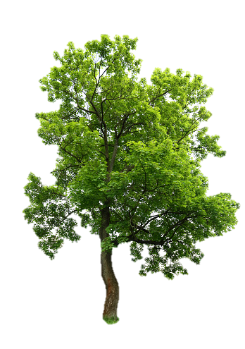
Today’s Route
You are here
Simple Java
For Loops
Conditions
Graphics
Review
The River of Java

Slide 14
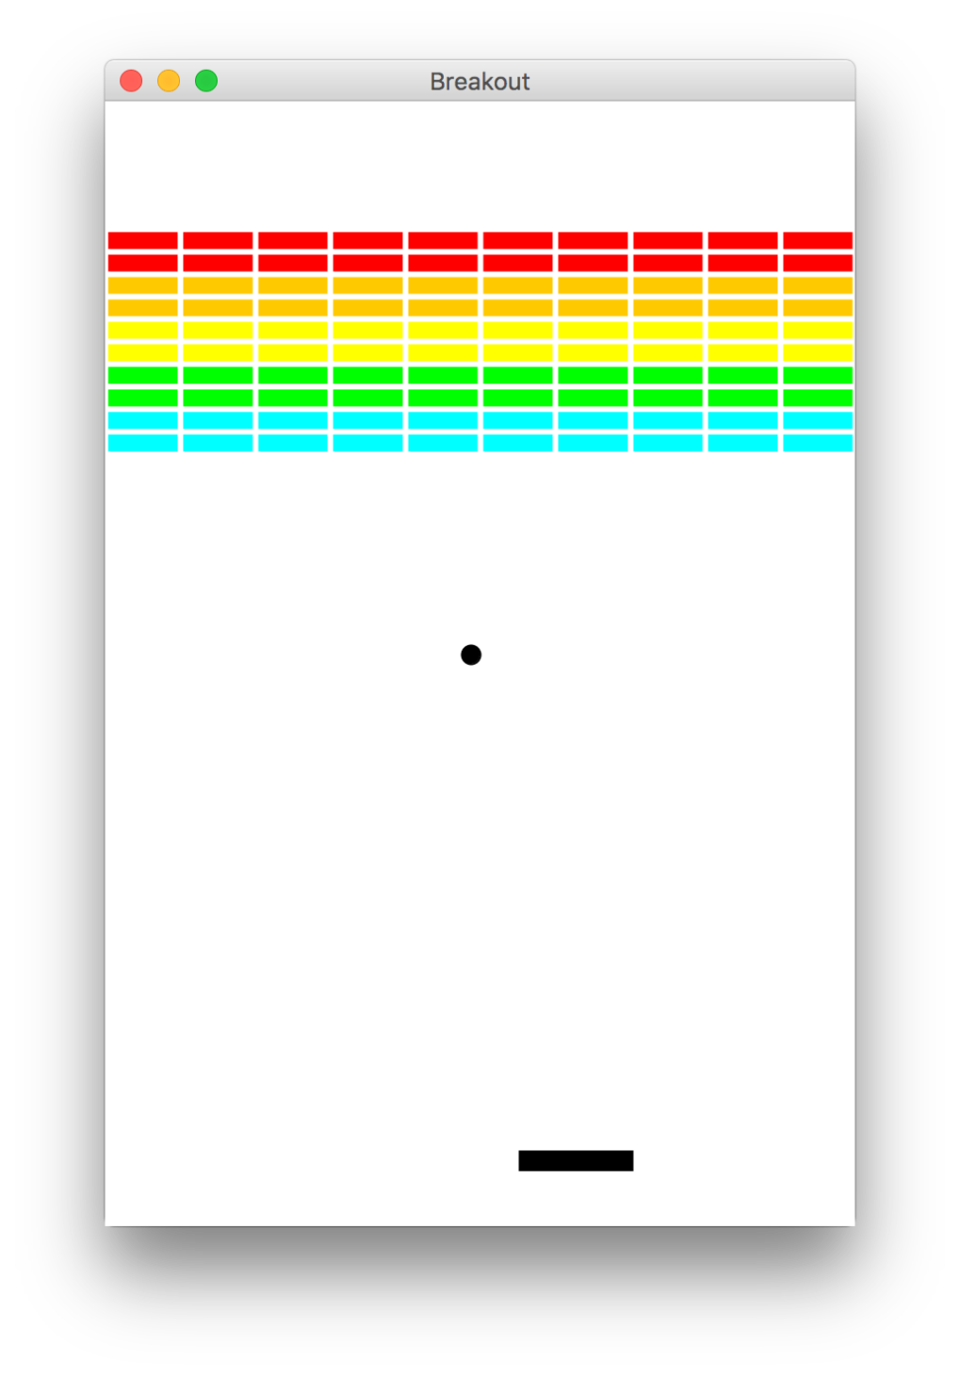
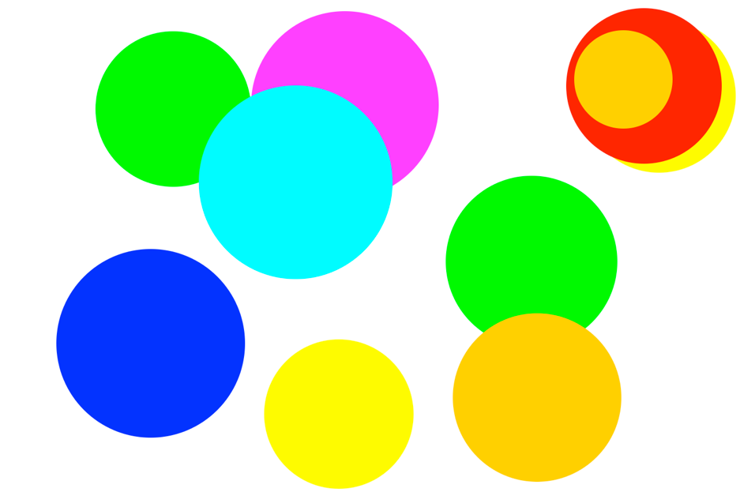
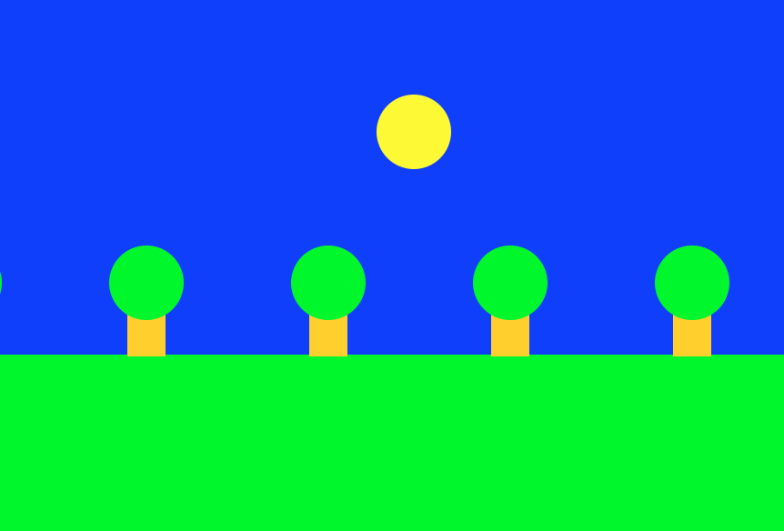
Graphics Programs

Slide 15
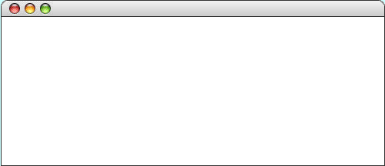
GRect
GRect is a variable type that stores a rectangle.
As an example, the following run method displays a blue square
public void run() {
Grect rect = new GRect(200, 200);
rect.setFilled(true);
rect.setColor(Color.BLUE);
add(rect, 50, 50);
}
LargestOval

Slide 16
Graphics Coordinates
0,0
40,20
120,40
getHeight();
40,120
getWidth();

Slide 17
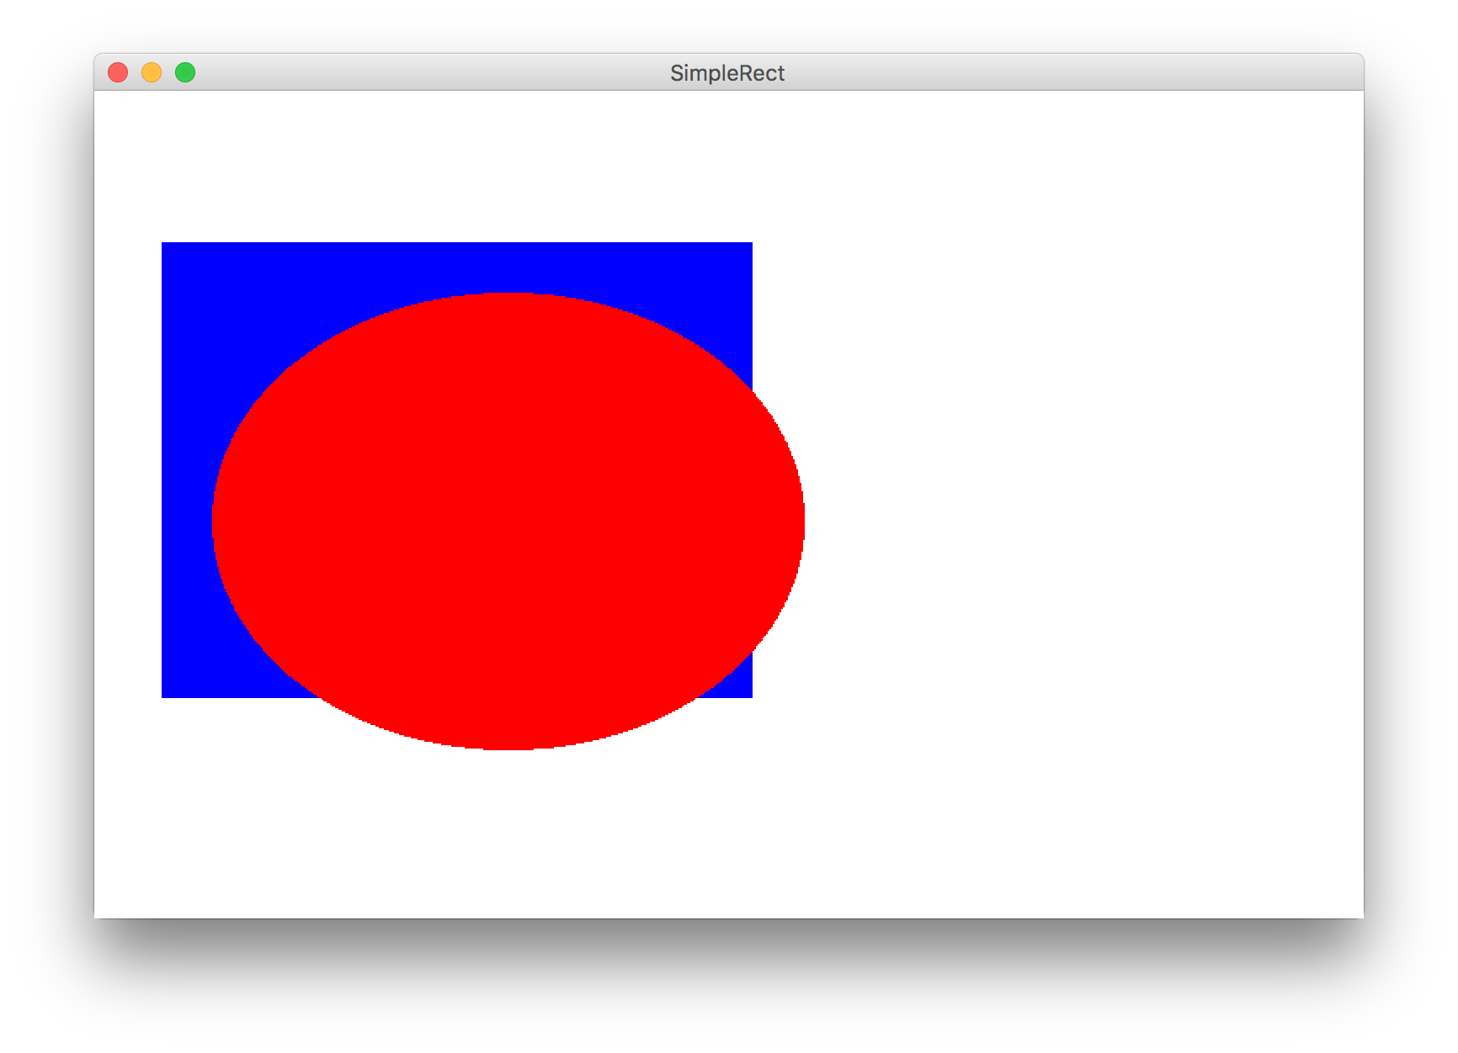
Learn By Example

Slide 18
Graphics Variable Types
GObject
GLabel
GRect
GOval
GLine
GRect myRect = new GRect(350, 270);

Slide 19
Primitives vs Classes
Primitive Variable Types
Class Variable Types
int
double
char
boolean
GRect
GOval
GLine
…
Class variables:
Have upper camel case types
You can call methods on them
Are constructed using new
Are stored in a special way

Slide 20
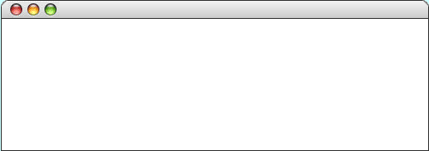
Graphics Trace
The following program illustrates sending a message to an object. Note that the label doesn’t appear until it is added to the canvas.
public class HelloProgram extends GraphicsProgram {
public void run() {
GLabel label = new GLabel("hello, world");
label.setFont("SansSerif-36");
label.setColor(Color.RED);
add(label, 100, 75);
}
}
label
hello, world
hello, world
hello, world
HelloProgram
hello, world
Graphic courtesy of Eric Roberts
skip simulation

Slide 21
Label Location
GLabel coordinates are baseline of first character
(0, 0)
HelloProgram
hello, world
(100, 75)
Graphic courtesy of Eric Roberts

Slide 22
Operations on GRect
object.setColor(color)
Sets the color of the object to the specified color constant.
The standard color names are defined in the java.awt package:
Color.BLACK
Color.DARK_GRAY
Color.GRAY
Color.LIGHT_GRAY
Color.WHITE
Color.RED
Color.YELLOW
Color.GREEN
Color.CYAN
Color.BLUE
Color.MAGENTA
Color.ORANGE
Color.PINK

Slide 23
Operations on GRect
object.setColor(color)
Sets the color of the object to the specified color constant.
object.setLocation(x, y)
Changes the location of the object to the point (x, y).
object.move(dx, dy)
Moves the object on the screen by adding dx and dy to its current coordinates.
object.setFilled( fill)
If fill is true, fills in the interior of the object; if false, shows only the outline.
object.setFillColor( color)
Sets the color used to fill the interior, which can be different from the border.
object.getWidth()
Returns the width of the rectangle.
object.getHeight()
Returns the height of the rectangle.

Slide 24
Operations on GOval
object.setColor(color)
Sets the color of the object to the specified color constant.
object.setLocation(x, y)
Changes the location of the object to the point (x, y).
object.move(dx, dy)
Moves the object on the screen by adding dx and dy to its current coordinates.
object.setFilled( fill)
If fill is true, fills in the interior of the object; if false, shows only the outline.
object.setFillColor( color)
Sets the color used to fill the interior, which can be different from the border.
object.getWidth()
Returns the width of the rectangle.
object.getHeight()
Returns the height of the rectangle.

Slide 25
Operations on GLabel
Methods specific to the GLabel class
label.setFont( font)
Sets the font used to display the label as specified by the font string.
label.getAscent( )
Returns the height of the label above its baseline.
label.getWidth( )
Returns the width of the label.
The font is typically specified as a string in the form
"family-style-size"
family is the name of a font family
style is either PLAIN, BOLD, ITALIC, or BOLDITALIC
size is an integer indicating the point size
Based on slides by Eric Roberts

Slide 26
Construction
new GRect( width, height)
Creates a rectangle with dimensions width and height.
new GOval(width, height)
Creates an oval that fits inside the rectangle with the same dimensions.
new GRect( x, y, width, height)
Creates a rectangle whose upper left corner is at (x, y) of the specified size.
new GOval( x, y, width, height)
Creates an oval that fits inside the rectangle with the same dimensions.
new GLabel( text)
Creates a label with the given text.
new GLine( x1, y1, x2, y2)
Creates a line with the given start and end points.
Based on slides by Eric Roberts

Slide 27
Graphics Methods
add( object)
Adds an object to the canvas. Location is not specified.
add( object, x, y)
Adds an object to the canvas at a specific location.
getWidth()
Returns the width of the screen.
getHeight( object, x, y)
Returns the height of the screen.
Based on slides by Eric Roberts

Slide 28
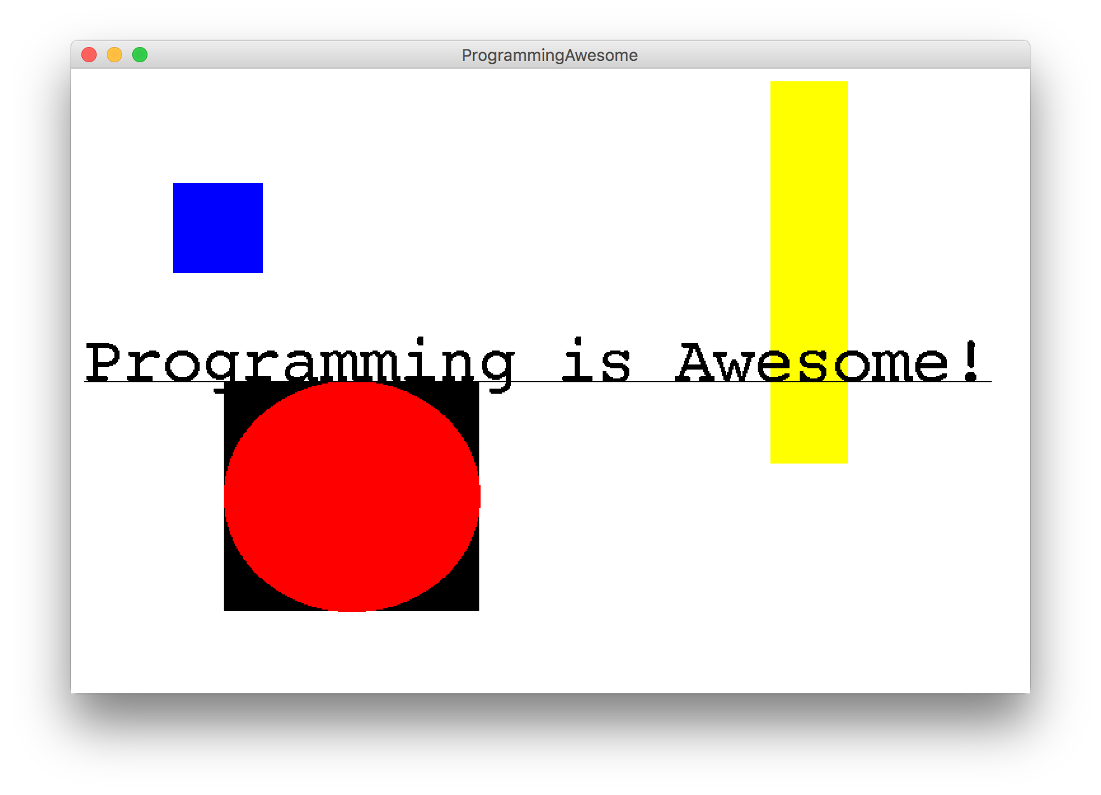
Another Example

Slide 29
Today’s Route
You are here
Simple Java
For Loops
Conditions
Graphics
Review
The River of Java

Slide 30
Today’s Route
You are here
Simple Java
For Loops
Conditions
Graphics
Review
The River of Java

Slide 31
While Loop in Karel
while(frontIsClear()) {
body
}
if(beepersPresent()) {
body
}

Slide 32
While Loop Redux
while(condition) {
body
}
if(condition) {
body
}
The condition should be a “boolean” which is either true or false

Slide 33
What Does This Do?
// read the amount of C14 from the user
double amount = readDouble("Amount of C14 in your sample: ");
// use the half life formula to calculate the age
double age = Math.log(amount/LIVING_C14) / Math.log(0.5) *
HALF_LIFE;
age = Math.round(age);
println("Your sample is " + age + " years old.");
* It calculates the age of a C14 sample

Slide 34
What Does This Do?
Before repeating the body, check if this statement evaluates to true
while(true) {
// read the amount of C14 from the user
double amount = readDouble("Amount of C14 in your sample: ");
// use the half life formula to calculate the age
double age = Math.log(amount/LIVING_C14) / Math.log(0.5) *
HALF_LIFE;
age = Math.round(age);
println("Your sample is " + age + " years old.");
// add an extra line between queries
println("");
}
* It repeatedly calculates the age of a C14 sample

Slide 35
Boolean Comparisons
==
Equals Test
!=
Not equals
<
Less than
>
Greater than
<=
Less than equals
>=
Greater than equals

Slide 36
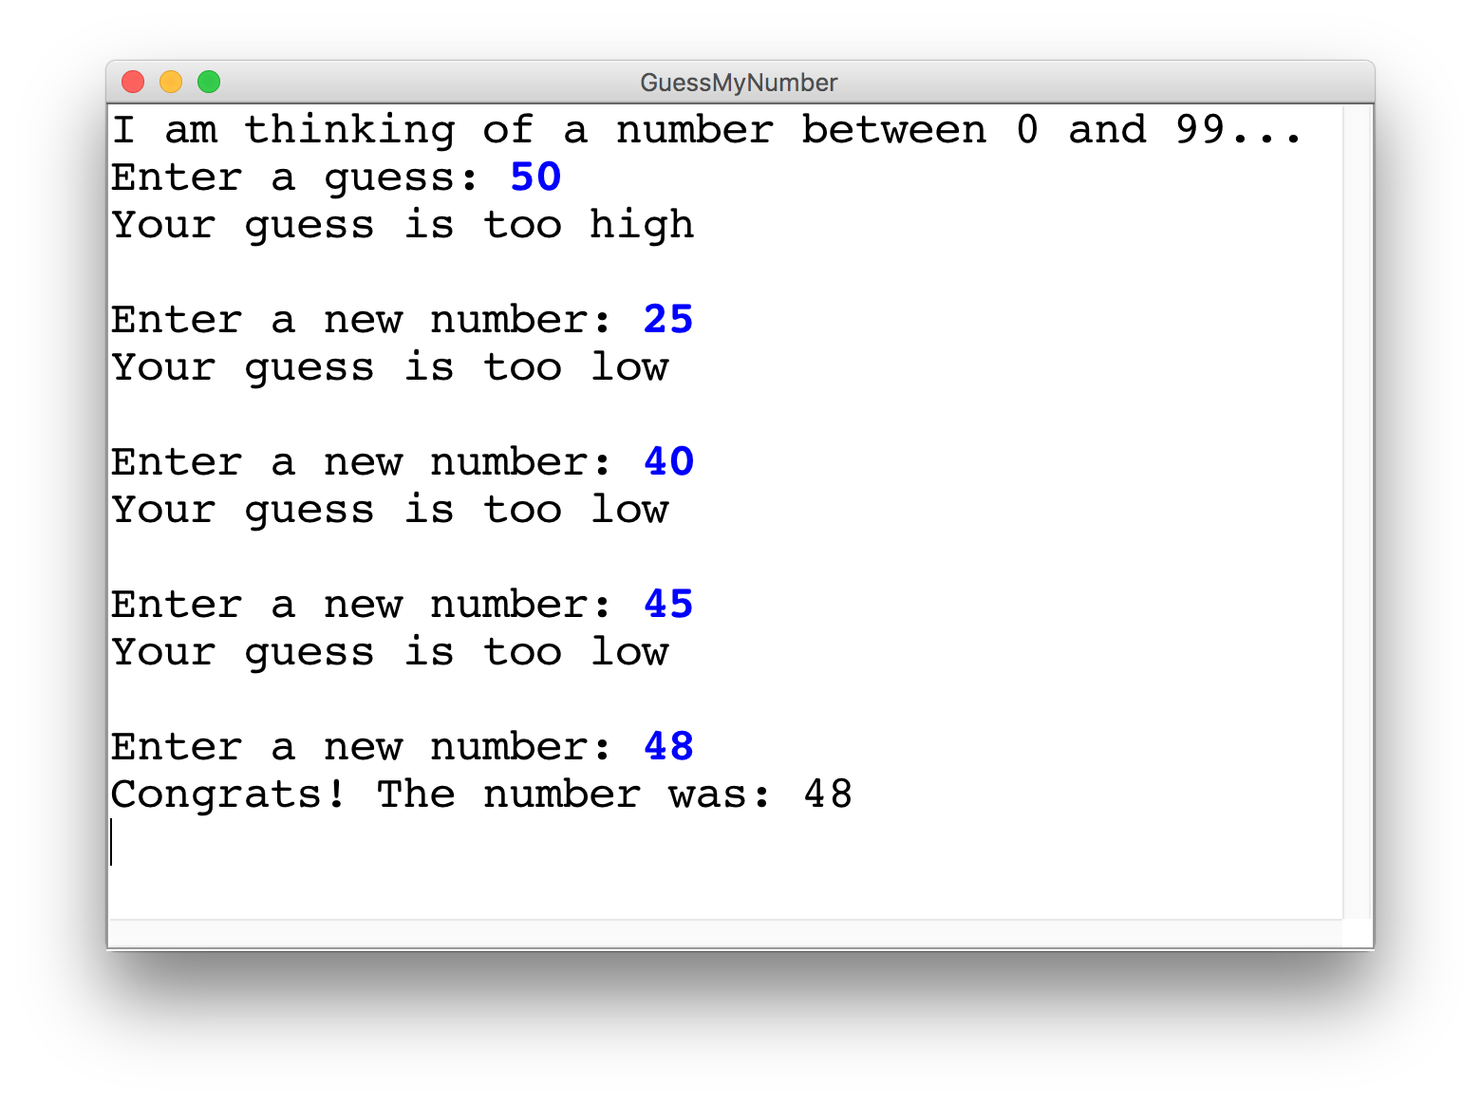
Guess My Number

Slide 37
Guess My Number
int secretNumber = getHeight() % 100;
println("I am thinking of a number between 0 and 99...");
int guess = readInt("Enter a guess: ");
// true if guess is not equal to secret number
while(guess != secretNumber) {
// true if guess is less than secret number
if(guess < secretNumber) {
println("Your guess is too low");
} else {
println("Your guess is too high");
}
println(""); // an empty line
guess = readInt("Enter a new number: ");
}
println("Congrats! The number was: " + secretNumber);

Slide 38
How would you println “Nick rocks socks”
100 times

Slide 39
For Loop Redux
public void run() {
for(int i = 0; i < 100; i++) {
println(“Nick rocks socks!”);
}
}

Slide 40
For Loop Redux
Enters the loop if this condition passes
This line is run each time the code gets to the end of the ‘body’
This line is run once, just before the for loop starts
for(int i = 0; i < 100; i++) {
println(“Nick rocks socks!”);
}

Slide 41

For Loop Redux
for(int i = 0; i < 3; i++) {
println(“Nick rocks socks!”);
}
For Loop Redux

Slide 42
For Loop Redux
for(int i = 0; i < 3; i++) {
println(“Nick rocks socks!”);
}
For Loop Redux

Slide 43
For Loop Redux
i
0
for(int i = 0; i < 3; i++) {
println(“Nick rocks socks!”);
}
For Loop Redux

Slide 44
For Loop Redux
i
0
for(int i = 0; i < 3; i++) {
println(“Nick rocks socks!”);
}
For Loop Redux

Slide 45
For Loop Redux
i
0
for(int i = 0; i < 3; i++) {
println(“Nick rocks socks!”);
}
For Loop Redux
Nick rocks socks

Slide 46
For Loop Redux
i
1
for(int i = 0; i < 3; i++) {
println(“Nick rocks socks!”);
}
For Loop Redux
Nick rocks socks

Slide 47
For Loop Redux
i
1
for(int i = 0; i < 3; i++) {
println(“Nick rocks socks!”);
}
For Loop Redux
Nick rocks socks

Slide 48
For Loop Redux
i
1
for(int i = 0; i < 3; i++) {
println(“Nick rocks socks!”);
}
For Loop Redux
Nick rocks socks
Nick rocks socks

Slide 49
For Loop Redux
i
2
for(int i = 0; i < 3; i++) {
println(“Nick rocks socks!”);
}
For Loop Redux
Nick rocks socks
Nick rocks socks

Slide 50
For Loop Redux
i
2
for(int i = 0; i < 3; i++) {
println(“Nick rocks socks!”);
}
For Loop Redux
Nick rocks socks
Nick rocks socks

Slide 51
For Loop Redux
i
2
for(int i = 0; i < 3; i++) {
println(“Nick rocks socks!”);
}
For Loop Redux
Nick rocks socks
Nick rocks socks
Nick rocks socks

Slide 52
For Loop Redux
i
3
for(int i = 0; i < 3; i++) {
println(“Nick rocks socks!”);
}
For Loop Redux
Nick rocks socks
Nick rocks socks
Nick rocks socks

Slide 53
For Loop Redux
i
3
for(int i = 0; i < 3; i++) {
println(“Nick rocks socks!”);
}
For Loop Redux
Nick rocks socks
Nick rocks socks
Nick rocks socks

Slide 54
For Loop Redux
for(int i = 0; i < 3; i++) {
println(“Nick rocks socks!”);
}
For Loop Redux
Nick rocks socks
Nick rocks socks
Nick rocks socks

Slide 55
For Loop Redux
for(int i = 0; i < 3; i++) {
println(“Nick rocks socks!”);
}
For Loop Redux
Nick rocks socks
Nick rocks socks
Nick rocks socks

Slide 56
You can use the for loop variable

Slide 57
How would you println the first 100 even numbers?

Slide 58
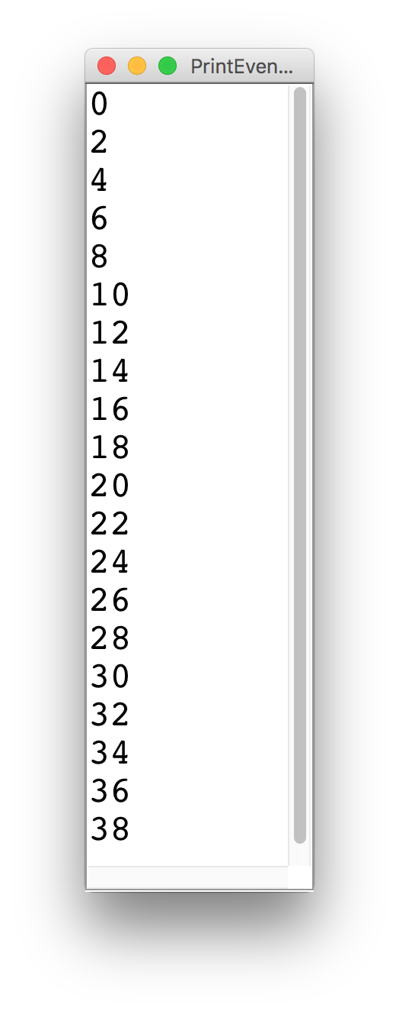
Printing Even Numbers

Slide 59
Printing Even Numbers
for(int i = 0; i < NUM_NUMS; i++) {
println(i * 2);
}

Slide 60
Printing Even Numbers
for(int i = 0; i < 3; i++) {
println(i * 2);
}
For Loop Redux

Slide 61
Printing Even Numbers
for(int i = 0; i < 3; i++) {
println(i * 2);
}
For Loop Redux

Slide 62
Printing Even Numbers
i
0
for(int i = 0; i < 3; i++) {
println(i * 2);
}
For Loop Redux

Slide 63
Printing Even Numbers
i
0
for(int i = 0; i < 3; i++) {
println(i * 2);
}
For Loop Redux

Slide 64
Printing Even Numbers
i
0
for(int i = 0; i < 3; i++) {
println(i * 2);
}
For Loop Redux
0

Slide 65
Printing Even Numbers
i
1
for(int i = 0; i < 3; i++) {
println(i * 2);
}
For Loop Redux
0

Slide 66
Printing Even Numbers
i
1
for(int i = 0; i < 3; i++) {
println(i * 2);
}
For Loop Redux
0

Slide 67
Printing Even Numbers
i
1
for(int i = 0; i < 3; i++) {
println(i * 2);
}
For Loop Redux
0
2

Slide 68
Printing Even Numbers
i
2
for(int i = 0; i < 3; i++) {
println(i * 2);
}
For Loop Redux
0
2

Slide 69
Printing Even Numbers
i
2
for(int i = 0; i < 3; i++) {
println(i * 2);
}
For Loop Redux
0
2

Slide 70
Printing Even Numbers
i
2
for(int i = 0; i < 3; i++) {
println(i * 2);
}
For Loop Redux
0
2
4

Slide 71
Printing Even Numbers
i
3
for(int i = 0; i < 3; i++) {
println(i * 2);
}
For Loop Redux
0
2
4

Slide 72
Printing Even Numbers
i
3
for(int i = 0; i < 3; i++) {
println(i * 2);
}
For Loop Redux
0
2
4

Slide 73
Printing Even Numbers
i
3
for(int i = 0; i < 3; i++) {
println(i * 2);
}
For Loop Redux
0
2
4

Slide 74
Printing Even Numbers
for(int i = 0; i < 3; i++) {
println(i * 2);
}
For Loop Redux
0
2
4

Slide 75
Today’s Route
You are here
Simple Java
For Loops
Conditions
Graphics
Review
The River of Java

Slide 76
Today’s Route
You are here
Simple Java
For Loops
Conditions
Graphics
Review
The River of Java

Slide 77
Today’s Goal
Know how to use graphics variables
Understand For / While / If in Java

Slide 78
String Art

